Slide 1
REVIEW-3:
Facial attribute Analysis & Recognition Using Opencv, CNN
Done by :
B.V. Harshavardhan(19MIS1203)
Under the guidance of DR. S JAHANGEER SIDIQ

Slide 2
Outline:
1. Introduction
2. Literature Review
3. Gaps based on current scenario
4. Scope and Problem Statement
5. Research Challenges
6. Research Objective
7. Methodology
8. Results and Discussion
9. References

Slide 3
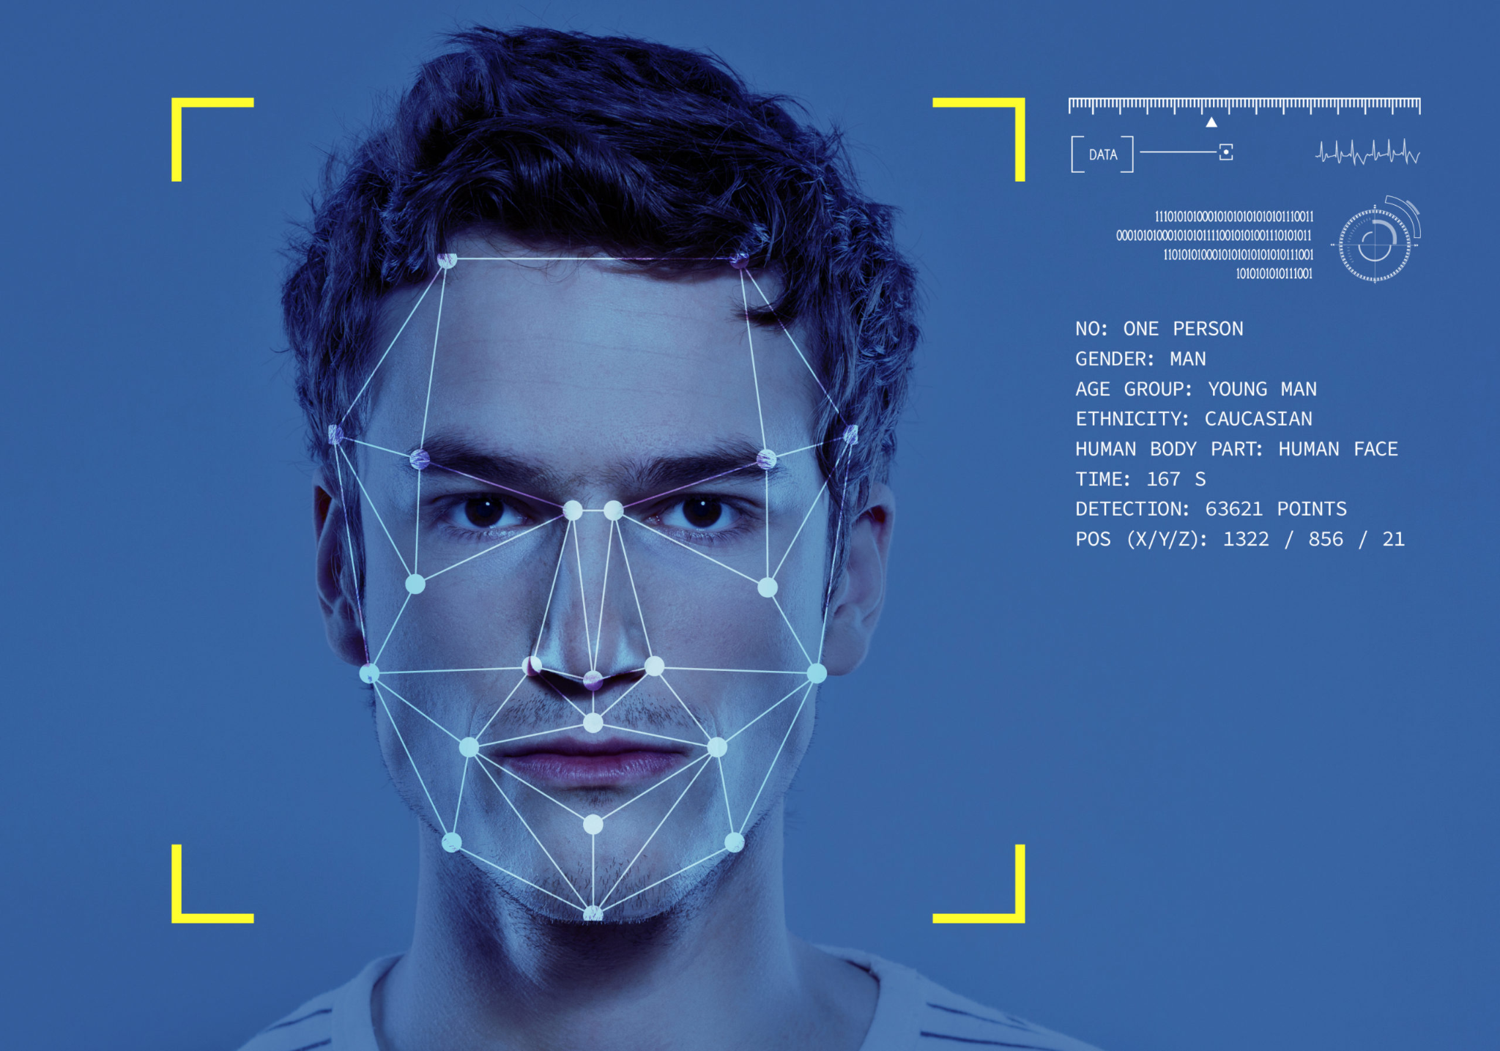
Introduction:
Facial Attribute Analysis, a pivotal aspect of computer vision in artificial intelligence, identifies and quantifies various human facial attributes such as age, gender, emotion, and ethnicity. Its applications span from security through facial recognition to customer experience enhancement in retail.
A prime example of this technology is Facebook AI's 'Deepface,' which achieves near-human accuracy in facial recognition. Deepface creates a 3D face model, normalizes it to address pose and illumination variations, and uses a deep neural network for precise feature extraction and classification.
This report aims to explore the mechanisms and applications of facial attribute analysis, focusing on Deepface and CNNs, their challenges, and prospects. We will examine the technical foundations of CNNs, the architecture of Deepface, and the broader impact of this technology in various sectors.

Slide 4
Paper Title | Authors | Summary | Accuracy Achieved
[1]FaceNet: A Unified Embedding for Face Recognition and Clustering | Florian Schroff, Dmitry Kalenichenko, and James Philbin (2015) | Introduced FaceNet, a deep learning model that learns a mapping from face images to a compact Euclidean space where distances directly correspond to a measure of face similarity. | 99.63% on LFW 95.12% on YouTube Faces DB
[2]DeepFace: Closing the Gap to Human-Level Performance in Face Verification | Yaniv Taigman, Ming Yang, Marc'Aurelio Ranzato, and Lior Wolf (2014) | Facebook's DeepFace system utilized a deep learning architecture to achieve high accuracy in face verification tasks, approaching human-level performance. | accuracy of 97.35% on the (LFW) dataset; Reducement of error by 27% compared to other ‘state-of-the-art’ algorithms.
[3]VGG Face | Omkar M. Parkhi, Andrea Vedaldi, and Andrew Zisserman (2015) | Introduced the VGGFace dataset and a series of neural network architectures for face recognition, demonstrating state-of-the-art performance on benchmark datasets.

Slide 5
Paper Title | Authors | Summary | Accuracy Achieved
[4] ArcFace: Additive Angular Margin Loss for Deep Face Recognition | Jiankang Deng, Jia Guo, Niannan Xue, and Stefanos Zafeiriou (2019) | Introduced an additive angular margin loss function, enhancing the discriminative capability of deep networks for face recognition tasks. Achieved state-of-the-art results on various benchmarks. | 99.83% in LFW; 98.02% IN YTF DATASETS
[5] DeepID3: Face Recognition with Very Deep Neural Networks | Yi Sun, Xiaogang Wang, and Xiaoou Tang (2015) | Proposed a deeply learned representation for face images. The model was trained using a large-scale dataset and demonstrated improved performance on face verification and identification tasks. | accuracy improvement in face verification from 99.47% to 99.53% and in rank-1 face identification from 95.0% to 96.0% on the LFW dataset
[6] Joint Face Detection and Alignment Using Multitask Cascaded Convolutional Networks | Kaipeng Zhang, Zhanpeng Zhang, Zhifeng Li, and Yu Qiao (2016) | Proposed a multitask learning framework for joint face detection and alignment, achieving state-of-the-art results on standard benchmarks.
[7 ]Deep Residual Learning for Image Recognition | Kaiming He, Xiangyu Zhang, Shaoqing Ren, and Jian Sun (2016) | Although primarily focused on general image recognition, ResNet architectures have been widely adopted in face recognition tasks due to their ability to train very deep networks effectively.

Slide 6
Paper Title | Authors (Year) | Summary
[9]Dlib-ml: A Machine Learning Toolkit | Davis E. King (2009) | Dlib is an open-source toolkit providing machine-learning algorithm implementations, including facial recognition. Widely utilized in research and practical applications, however, the specific accuracy metrics for facial recognition are not provided in the summary.
[10]Age and Gender Classification Using Convolutional Neural Networks | Gil Levi and Tal Hassner (2015) | Demonstrated the effectiveness of convolutional neural networks for age and gender classification in facial attribute recognition, crucial for facial recognition systems, and thus indicated as an effective component of facial recognition systems.
[12]Deep FaceRecognizer: A Deep Learning-Based Face Recognition Toolkit | Lin Wu, Gang Wang, and Zhihua Zhou (2017) | Presented a deep learning toolkit tailored for face recognition tasks, offering a practical implementation of deep neural networks for facial recognition applications. However, specific accuracy metrics are not explicitly stated in the summary.

Slide 7
Paper Title | Authors (Year) | Summary
[13]Face Recognition: Recent Advancements and Research Challenges | M. Jha, A. Tiwari, M. Himansh, and V. M. Manikandan (2022) | Discusses recent advancements and research challenges in face recognition. No specific summary details provided in the given information.
[14]Deep Face Recognition: A Survey | I. Masi, Y. Wu, T. Hassner, and P. Natarajan (2018) | A survey on deep face recognition, providing an overview of the field. The summary is not outlined in the provided information.
[15]Comparison of Face Recognition Accuracy of ArcFace, Facenet and Facenet512 Models on Deepface Framework | A. Firmansyah, T. F. Kusumasari, and E. N. Alam (2023) | Compares the face recognition accuracy of ArcFace, Facenet, and Facenet512 models on the Deepface framework. No detailed summary is given in the provided information.
[16]Surveillance System for Real-Time High-Precision Recognition of Criminal Faces From Wild Videos | H.-B. Kim, N. Choi, H.-J. Kwon, and H. Kim (2023) | Describes a surveillance system for real-time high-precision recognition of criminal faces from wild videos, with a focus on real-time recognition. The summary doesn't include specific accuracy details.

Slide 8
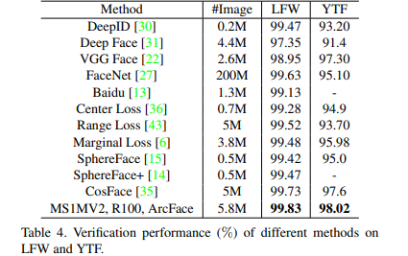
Accuracy of the mentioned above algorithms on YTF and LFW Datasets.
Source: ArcFace: Additive Angular Margin Loss for Deep Face Recognition" by Jiankang Deng, Jia Guo, Niannan Xue, and Stefanos Zafeiriou (2019):

Slide 9
Gaps Based on Current Scenario
A. Accuracy and Bias:
Accuracy Issues: Facial recognition systems often struggle with accuracy, especially for certain demographic groups, such as people with darker skin tones and women. This inaccuracy can lead to misidentifications and false positives/negatives.
Bias: Many facial recognition algorithms show bias towards specific ethnicities, genders, and age groups. This bias can result in discriminatory outcomes, reinforcing existing societal biases and leading to unjust actions.
B. Privacy Concerns:
Data Privacy: Facial recognition systems rely on vast amounts of data, raising concerns about the privacy of individuals. Unauthorized access or misuse of this data can lead to serious privacy breaches.
Mass Surveillance: The use of facial recognition in mass surveillance by governments and private entities has raised significant privacy concerns, as it enables constant tracking and monitoring of individuals without their consent.

Slide 10
Understanding the problems
A. Security Risks:
Spoofing and Deep Fakes: Facial recognition systems can be tricked by high-quality spoofing attacks and deepfake technology, where malicious actors can create realistic fake videos or images to deceive the system.
Hacking and Unauthorized Access: Security vulnerabilities in facial recognition databases can be exploited by hackers to gain unauthorized access to sensitive information, leading to identity theft or other cybercrimes.
B. Legal and Ethical Challenges:
Regulation: There is a lack of comprehensive regulations governing the use of facial recognition technology, leading to inconsistent standards and practices across different regions and industries.
Ethical Implications: The ethical implications of facial recognition, such as consent, autonomy, and human rights, are complex and need careful consideration. The technology often outpaces the development of ethical frameworks to guide its responsible use.

Slide 11
C. Technological Limitations:
Low-Quality Images: Facial recognition accuracy significantly drops with low-quality or pixelated images, limiting its effectiveness in real-world scenarios where the quality of surveillance footage may be poor.
Real-time Processing: Real-time processing of facial recognition data can be resource-intensive, requiring powerful hardware and algorithms. Achieving seamless real-time recognition in various environments remains a technological challenge.

Slide 12
Problem Statement
In today's rapidly advancing technological landscape, traditional methods of attendance management have become increasingly inadequate, time-consuming, and prone to errors. Manual attendance processes not only consume valuable time but also bear the risk of inaccuracies due to human oversight. To address these challenges, we propose the development of an Automated Attendance System leveraging the power of facial recognition technology and Python programming modules such as cv2, numpy, csv, os, and datetime.
The primary challenge lies in developing a system that can accurately and efficiently recognize individuals in real-time through facial analysis. Achieving a high recognition rate across diverse demographic groups, lighting conditions, and facial expressions is crucial. Additionally, ensuring robust security measures to prevent unauthorized access and safeguard against potential threats like spoofing, photographs, or deepfake attempts is paramount.

Slide 13
Research challenges
Accuracy and Robustness: Improving the accuracy of face recognition algorithms, especially in challenging conditions such as varying lighting, facial expressions, and pose variations. Enhancing the robustness of algorithms to accurately recognize faces in real-world scenarios is crucial.
Data Quality and Quantity: Acquiring and curating large, diverse, and high-quality facial datasets is essential for training accurate and reliable face recognition models. Research is needed to address issues related to dataset bias, imbalance, and annotation quality.
Cross-Dataset and Cross-Domain Recognition: Developing techniques that enable face recognition models trained on one dataset or domain to generalize well to other datasets or domains, reducing the need for extensive retraining when deploying the technology in different real-world applications.

Slide 14
Privacy Preservation: Addressing privacy concerns related to facial recognition technology, such as developing methods for privacy-preserving face recognition, ensuring that facial data is anonymized and cannot be easily misused, and exploring techniques like homomorphic encryption.
Ethical and Societal Implications: Investigating the ethical implications of face recognition, including issues related to consent, surveillance, and the potential for biased or discriminatory outcomes. Research is needed to establish guidelines and regulations governing the ethical use of face recognition technology.

Slide 15
Privacy-Preserving Face Recognition: Investigate privacy-preserving techniques, such as homomorphic encryption and federated learning, to ensure that facial data can be processed for recognition purposes without compromising individuals' privacy and data security.
Anti-Spoofing and Security: Develop robust anti-spoofing techniques to detect and prevent spoofing attacks, ensuring that the system can distinguish between genuine facial features and fake representations, including photos, videos, or masks.

Slide 16
Research objective:
Enhancing Recognition Accuracy: Improve the accuracy of face recognition systems by developing advanced algorithms that can effectively handle variations in lighting conditions, facial expressions, pose, and occlusions, leading to reliable recognition outcomes.
Robustness to Environmental Factors: Develop techniques that enable face recognition systems to perform well in various environmental conditions, including low-light environments, different weather conditions, and varying camera qualities, ensuring consistent performance regardless of the setting.
Cross-Dataset Generalization: Research methods to enhance the ability of face recognition models to generalize across different datasets and domains, reducing the need for retraining when deploying the technology in diverse real-world scenarios.

Slide 17
METHODOLOGY:
->Data Collection and Preprocessing
-> Algorithm Selection and Development
-> Training and Optimization
-> Evaluation and Validation
-> Testing the accuracy
-> Using it in a simple application

Slide 18

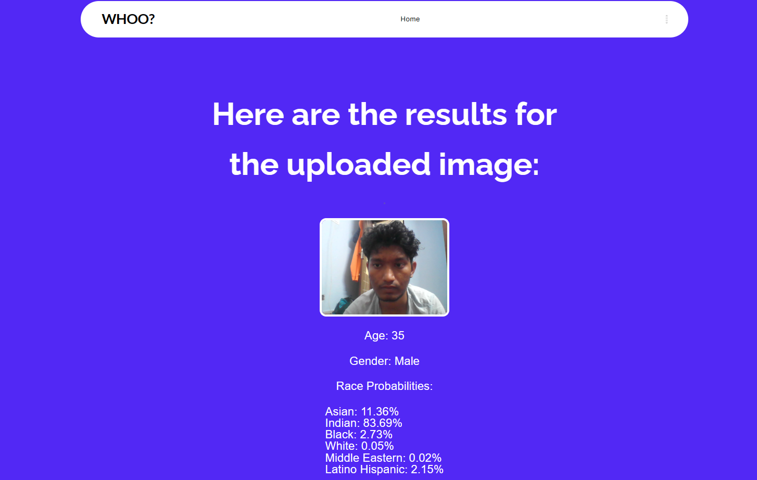
Code and Final Output:

Slide 19

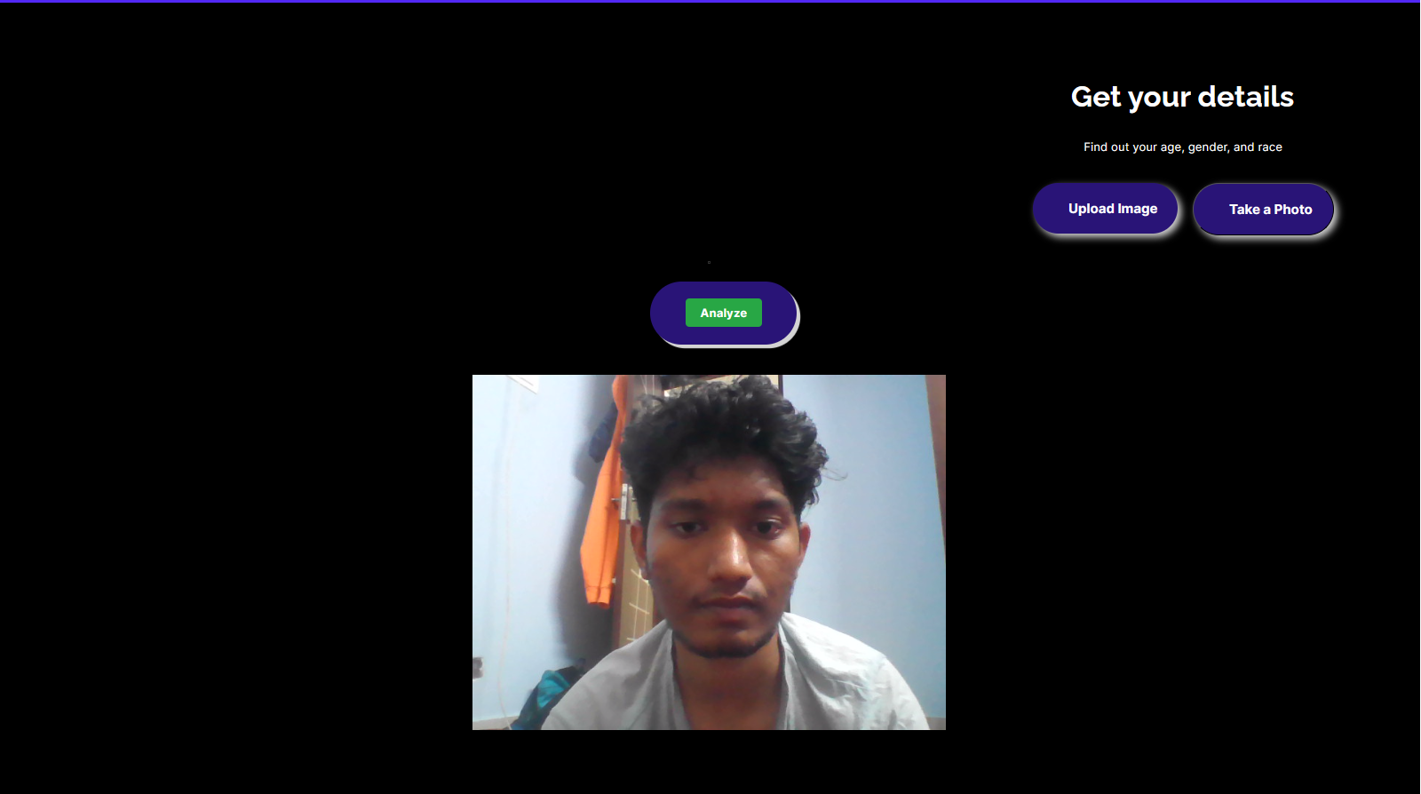
Results and Discussion:
A minimalist website for the Facial Attribute Analysis:

Slide 20
Comparative Analysis b/w the two Models:
Algorithms |  | Attributes
 | Age (MAE) | Gender (Accuracy) | Race (Accuracy)
Custom Model | 14.667972297991 | 0.6850622406639004 | 0.4466804979253112
Deepface | 12.32 | 0.773823756 | 0.615996426

Slide 21
References:
[1] Turk, M., & Pentland, A. (1991). Eigenfaces for Recognition. Journal of Cognitive Neuroscience
[2] H. -B. Kim, N. Choi, H. -J. Kwon and H. Kim, "Surveillance System for Real-Time High-Precision Recognition of Criminal Faces From Wild Videos," in IEEE Access, vol. 11, pp. 56066-56082, 2023, doi: 10.1109/ACCESS.2023.3282451.
[3] “UTKFace_LFW Dataset.” Utkface, susanqq.github.io/UTKFace/
[4] "FaceNet: A Unified Embedding for Face Recognition and Clustering" by Florian Schroff, Dmitry Kalenichenko, and James Philbin (2015):.
[5] Taigman, Y., Yang, M., Ranzato, M., & Wolf, L. (2014). DeepFace: Closing the Gap to Human-Level Performance in Face Verification. Conference on Computer Vision and Pattern Recognition (CVPR).
[6] M. Jha, A. Tiwari, M. Himansh and V. M. Manikandan, "Face Recognition: Recent Advancements and Research Challenges," 2022 13th International Conference on Computing Communication and Networking Technologies (ICCCNT), Kharagpur, India, 2022, pp. 1-6, doi: 10.1109/ICCCNT54827.2022.9984308.

Slide 22
[7] I. Masi, Y. Wu, T. Hassner and P. Natarajan, "Deep Face Recognition: A Survey," 2018 31st SIBGRAPI Conference on Graphics, Patterns and Images (SIBGRAPI), Parana, Brazil, 2018, pp. 471-478, doi: 10.1109/SIBGRAPI.2018.00
[8] A. Firmansyah, T. F. Kusumasari and E. N. Alam, "Comparison of Face Recognition Accuracy of ArcFace, Facenet and Facenet512 Models on Deepface Framework," 2023 International Conference on Computer Science, Information Technology and Engineering (ICCoSITE), Jakarta, Indonesia, 2023, pp. 535-539, doi: 10.1109/ICCoSITE57641.2023.10127799.
[9] J. Deng, J. Guo, N. Xue and S. Zafeiriou, "ArcFace: Additive Angular Margin Loss for Deep Face Recognition," 2019 IEEE/CVF Conference on Computer Vision and Pattern Recognition (CVPR), Long Beach, CA, USA, 2019, pp. 4685-4694, doi: 10.1109/CVPR.2019.00482.
[10] Benjaminson, Emma. “Binary Cross-Entropy.” Binary Cross-Entropy – Emma Benjaminson – Mechanical Engineering Graduate Student, sassafras13.github.io/BiCE/
[11] “Categorical Cross-Entropy Loss.” Understanding Categorical Cross-Entropy Loss, Binary Cross-Entropy Loss, Softmax Loss, Logistic Loss, Focal Loss and All Those Confusing Names, gombru.github.io/2018/05/23/cross_entropy_loss/

Slide 23

Thank you!

